Slide 1
EAT, COOK, REPEAT a.k.a. MAMARECIPE
Bagus Dzikri Hidayat
BZ7830

Slide 2
Goals
Completing the API task in PijarCamp scholarship
Designing and developing the backend for Eat, Cook, Repeat recipe application
Designing the social media platform for all cooks to share all their recipes to everyone

Slide 3


Tech Stack (Back End)
A back end web application framework for Node.js, released as free and open-source
software under the MIT License. It is designed for building web applications and APIs. It has been
called the de facto standard server framework for Node.js (Wikipedia, 2022)
Also known as Postgres, is a free and open-source relational database management system
emphasizing extensibility and SQL compliance. It was originally named POSTGRES, referring to its origins
as a successor to the Ingres database developed at the University of California, Berkeley (Wikipedia, 2022)

Slide 4
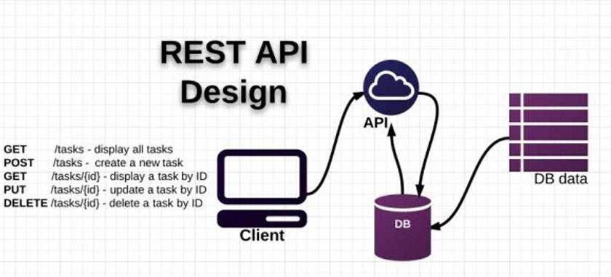
An architecture design of an API where an application can be integrated with another one in a software for data or resource access in the REST

Slide 5


A proposed Internet standard for creating data with optional signature and/or optional encryption whose
payload holds JSON that asserts some number of claims. The tokens are signed either using a private secret or a public/private key. (Wikipedia, 2021)
A NodeJS middleware for handling multipart/form-data, which is primarily used for uploading files. (https://github.com/expressjs/multer, 2021)

Slide 6


Tech Stack (Front End)
HTML5 is a markup language used for structuring and presenting content on the World Wide Web.. (Wikipedia, 2022)
CSS is a standard style sheet language used for describing the presentation (i.e. the layout and formatting) of the web pages (https://www.tutorialrepublic.com/css-tutorial/)

Slide 7

Bootstrap 5 is a open source framework for the visual design of a website

Slide 8
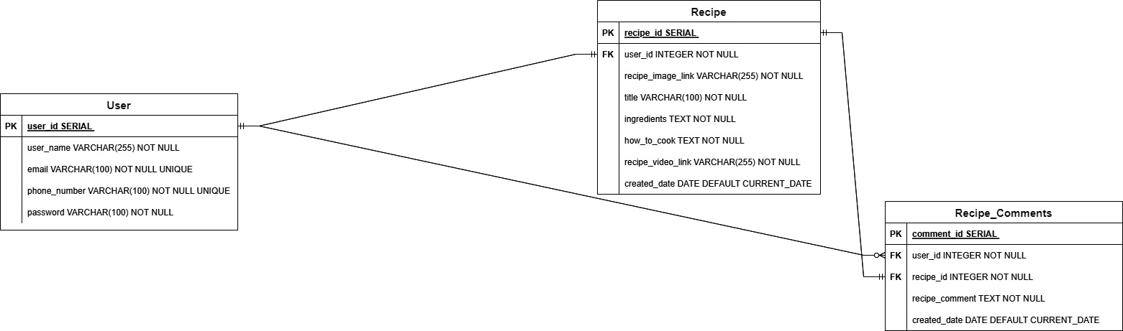
Entity Relational Diagram

Slide 9
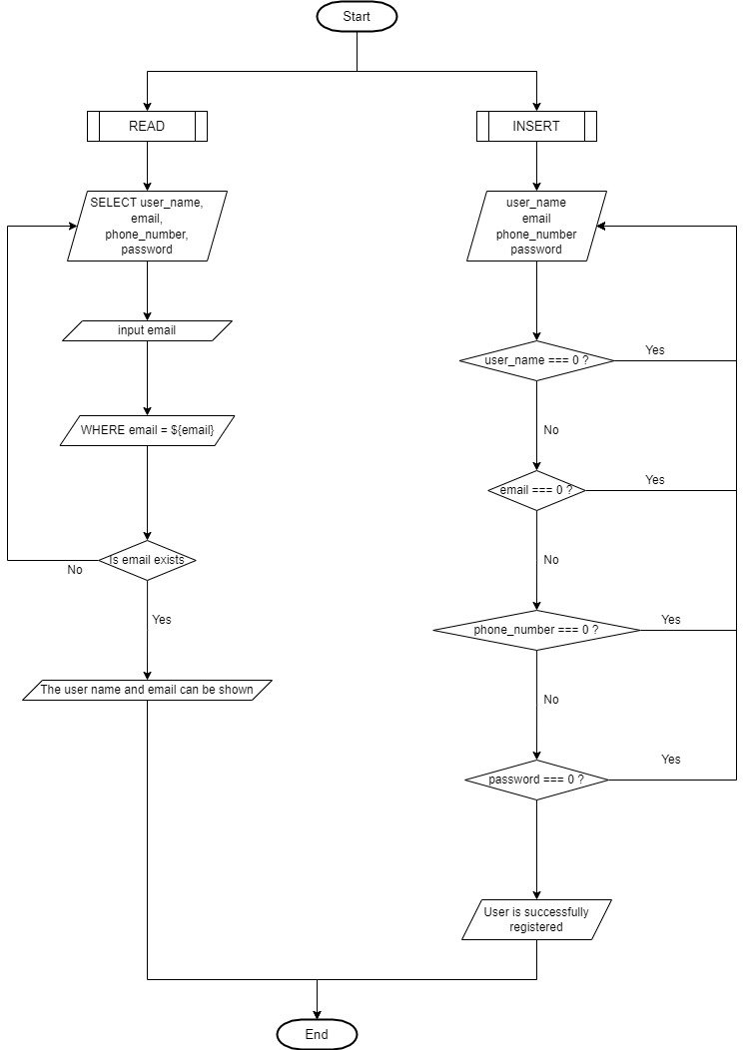
User CRUD Flowchart

Slide 10
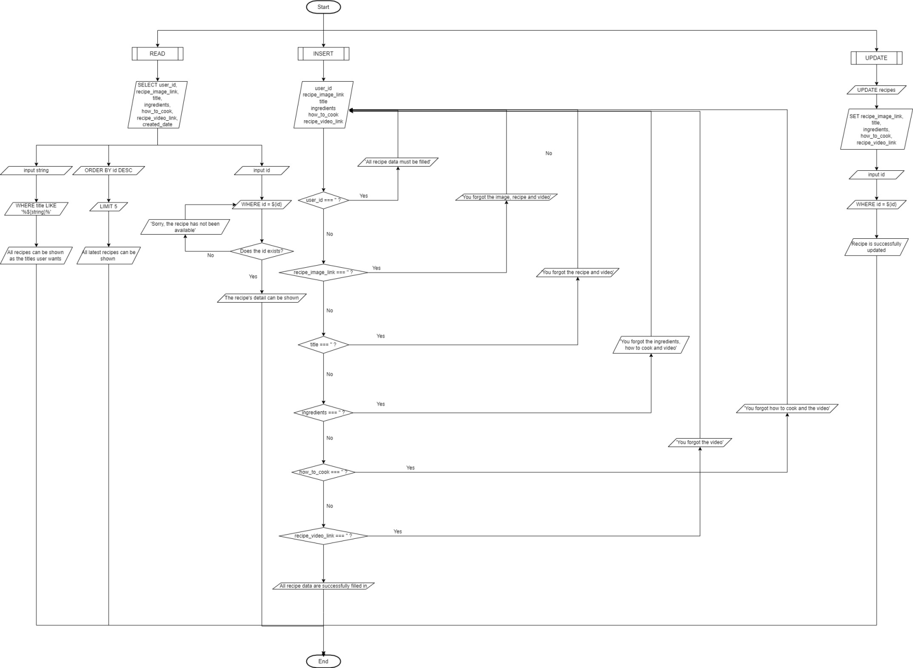
Recipe CRUD Flowchart

Slide 11
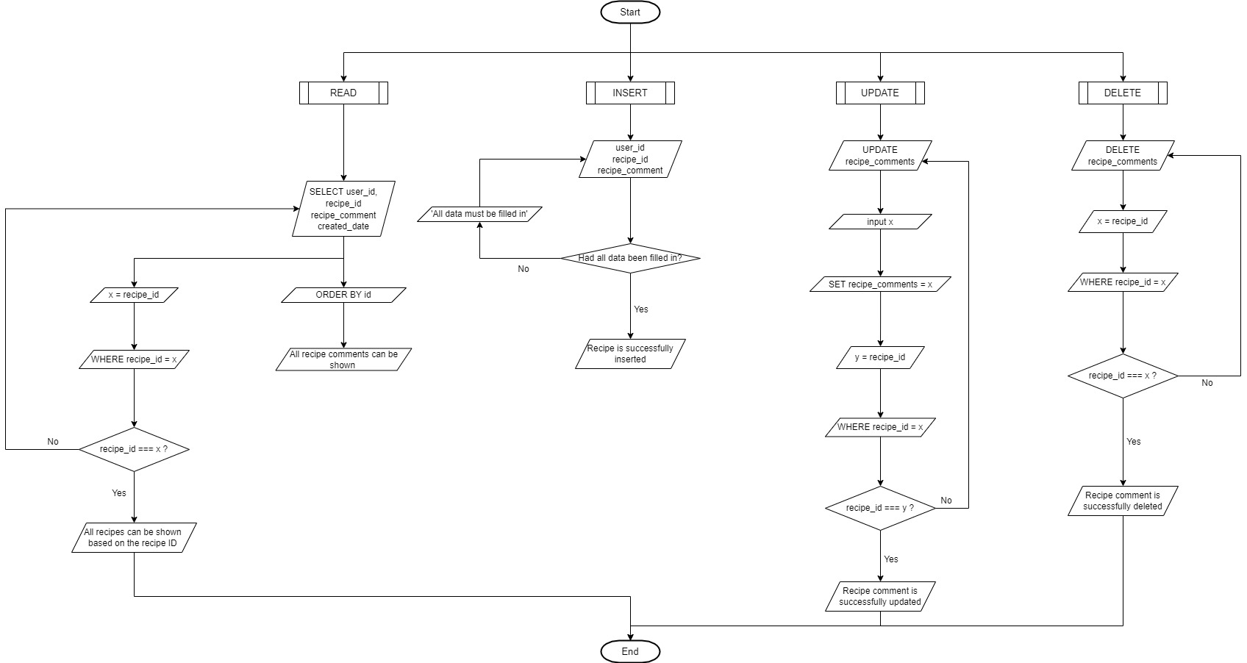
Recipe Comment CRUD Flowchart

Slide 12
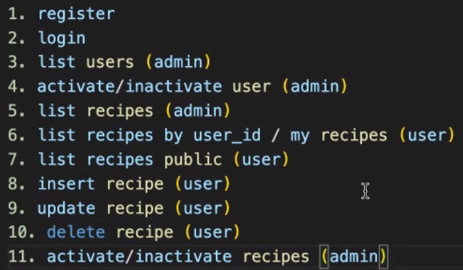
API Demo
localhost:5000/users/register
localhost:5000/users/login
localhost:5000/users
localhost:5000/users/activate/:id (for activating user)
localhost:5000/users/deactivate/:id (for deactivating user)
localhost:5000/recipes (for listing recipes)
localhost:5000/recipes/:id (for showing the user’s recipe details)
localhost:5000/
localhost:5000/recipes (for inserting recipes)
localhost:5000/recipes/:id (for updating recipes)
localhost:5000/recipes/:id (for deleting recipes)
localhost:5000/recipes/deactivate/:id (for deactivating user)
localhost:5000/recipes/reactivate/:id (for reactivating user)

Slide 13
Web Design Demo

Slide 14
Any Question Before Closing?

Slide 15
Thank You

